Slide 1
Solar Telemetry & AI Energy Prediction System
CAPSTONE PROJECT REVIEW
Real-Time Micro-Climate Monitoring & Machine Learning Forecasting for Household Solar
PRESENTED BY
Mohammed Faiz CK · Aryan Sovit · Yashwanth Chandawat

Slide 2
Project Overview & Objectives
Problem Statement
Proposed Solution
Rooftop solar output for households fluctuates with micro-climate changes such as passing clouds and panel heating, so homeowners cannot tell when it is best to run their appliances.
A home-focused telemetry dashboard that monitors real-time panel data, predicts energy output with an AI model, and turns it into simple guidance and savings for the household.
2 / 7 · IoT Solar Telemetry & AI Forecasting
Notes:
Target user: a homeowner with rooftop solar. Frame the problem as everyday decisions: when can I run the pump, fans or washing machine on solar?

Slide 3
System Architecture & Stack
Frontend
Backend & Telemetry
Database & AI
React.js
Tailwind CSS
Recharts for live wave visualizers
Node.js with Express API
Python (mock_telemetry.py) for live telemetry simulation
MongoDB for telemetry logs
LSTM neural network for solar power forecasting
3 / 7 · IoT Solar Telemetry & AI Forecasting
Notes:
Data flows from the Python simulator through the Express API into MongoDB, feeds the LSTM, and is rendered live in the React dashboard.

Slide 4


Key Features & UI Highlights
Consumer Mode for Homes
Live Telemetry Stream
Anomaly Simulation
Dual-axis chart tracking Actual Power Output against Irradiance in real time.
Controls to simulate cloud cover and panel overheating, showing how each affects what a household can run.
Smart recommendations (e.g. "Fans & Lights runnable now") and estimated daily savings. Pro Mode adds detailed technical readings.
4 / 7 · IoT Solar Telemetry & AI Forecasting
Notes:
Demo order: Consumer Mode recommendation first, then the live chart, then trigger cloud cover and watch the recommendation change. Briefly show Pro Mode.

Slide 5
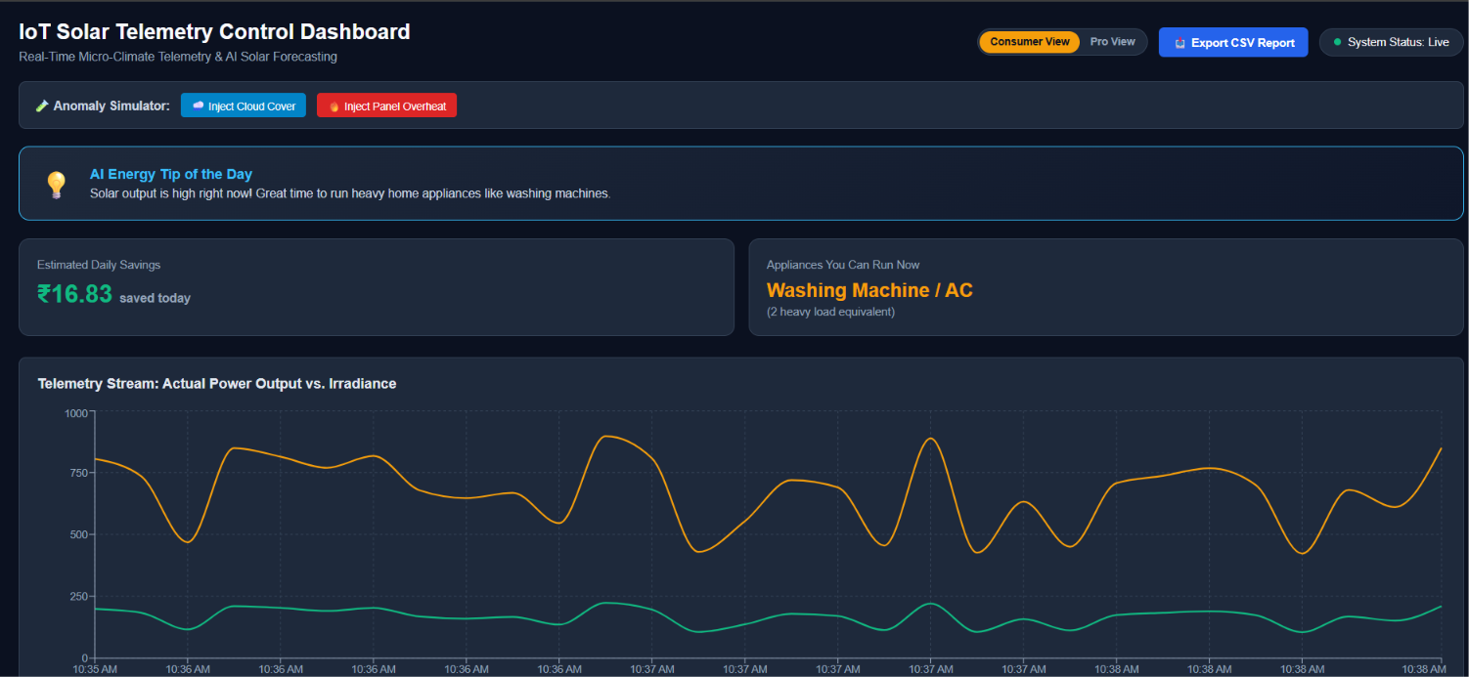
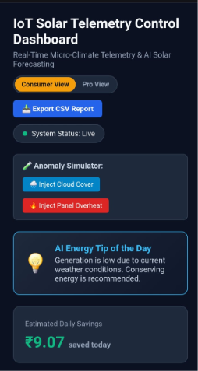
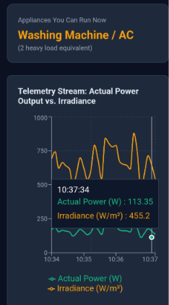
Frontend Development & Responsive Design
01
Refactored core CSS modules (App.css) for full mobile, tablet and desktop responsiveness, so homeowners can check it from a phone.
02
Flexible chart container scaling keeps graphs visible on smaller viewports.
03
Production build optimization and clean code architecture.
5 / 7 · IoT Solar Telemetry & AI Forecasting
Notes:
Show the dashboard at three breakpoints if time allows.

Slide 6
Current Status & Integration Workflow
COMPLETE
IN PLACE
PREPARED
Local Full-Stack Integration
Version Control & CI
Cloud Deployment
Continuous integration pipeline set up via the GitHub repository.
Live cloud setup prepared for deployment.
React, Express and Python scripts running together.
6 / 7 · IoT Solar Telemetry & AI Forecasting
Notes:
Be explicit that cloud deployment is prepared, not yet live.

Slide 7
Conclusion
To conclude, our project successfully delivers three core outcomes:
System Integration: A fully functional full-stack architecture combining live React visualizers, Node APIs, and Python telemetry scripts.
Consumer Value: Clear AI-driven guidance that directly helps households lower electricity bills and manage appliance usage.
Production Readiness: A mobile-responsive, deployment-ready dashboard with verified continuous integration pipelines.
Automated Smart-Grid Load Shifting
Advanced Multi-Step LSTM
7 / 7 · Thank you. Questions?
Notes:
Close by restating the contribution for household solar users, then invite panel questions.

